Slide 1
GalaxyDefenders
Pavan Gollapalli
Ben Liang
Andy Shen
APCS Period 4

Slide 2
Members
Andy - Graphics, Actors, Class Relationships
Ben - Movement, Project Manager
Pavan - Power-up design, Testing
Notes:
all

Slide 3
Background
Based on Japanese arcade game Space Invaders by Tomohiro Nishikado (1978)
2D shooting game with a controllable laser cannon and aliens that descend down towards the cannon
Used GridWorld case study program as starting point
Notes:
andy

Slide 4
How To Play
Press the enter key to start the game (aliens begin moving)
Arrow keys (left, right) control movement of sprite, spacebar triggers a bullet shot
Eliminate the aliens before they reach the row in front of the sprite
Notes:
andy

Slide 5
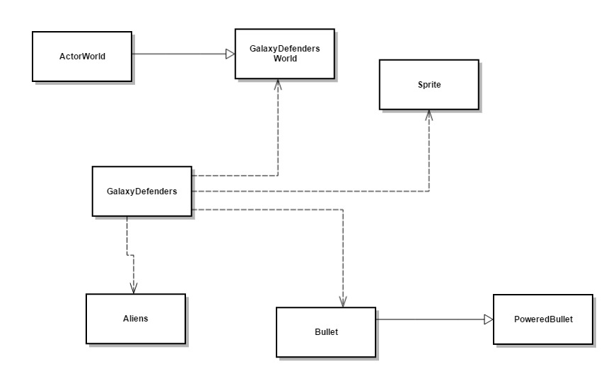
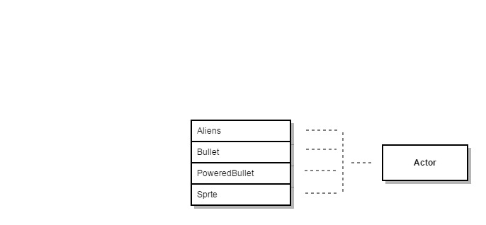
Design Elements
Notes:
pavan

Slide 6
Design Elements
LinkedList - Store Aliens
-Determines when the game ends (size = 0)
-No Priority (Every Alien is the same)
-Used to display the Enemy Counter
Notes:
pavan

Slide 7
Design Elements
javax.swing.Timer
-keeps alien movement in a loop
-regulates speed of bullets
-preferred to use loops because of scheduling function
Notes:
pavan

Slide 8
Design Elements
GridWorld
-Backbone of Galaxy Defenders
-Utilizes 2D arrays to store Aliens into GalaxyDefendersWorld
Notes:
pavan

Slide 9
Galaxy Defenders Classes
Notes:
Ben

Slide 10
GalaxyDefenders
Contains the Main method
Creates a new game.
Adds Actors to GalaxyDefendersWorld (Aliens/Sprites).
Determines when the game is considered won or lost.
Notes:
Ben

Slide 11
GalaxyDefendersWorld
Extends ActorWorld
Overrides the KeyPressed method
“LEFT/RIGHT” determines Sprite movement
“SPACE” determines Sprite shooting
“ENTER” determines the start of the game
Contains a LinkedList
Stores the number of aliens
Notes:
Ben

Slide 12
GalaxyDefendersWorld cont.
contains(Actor a) method
Helps determine if the game is lost.
Restricts player from firing multiple bullets.
getList() method
Returns the LinkedList containing Aliens, which allows for accessibility between classes.
Notes:
Ben

Slide 13

Sprite
Extends Actor.
Represents the user as a rocket ship.
Notes:
Ben

Slide 14

Alien
- Extends Bug
- Enemy character in game
- Appears in 3 rows (12, 11, 12)
- Uses Timer to move in increments of 1.5s
Notes:
Ben

Slide 15
Alien cont.
act() method
- Uses Timer, ActionListeners to move aliens in a specific pattern
move(int dir) method
- uses Gridworld to check location, moves alien to spot
- dir determines direction of movement
Notes:
Ben

Slide 16

Bullet
Extends Actor
goes forward until it reaches an alien
called by keyPressed() method
act() method
- uses Timer, ActionListeners to move until it hits boundary or alien
Notes:
Ben

Slide 17

Bullet cont.
move() method
-uses GridWorld to move forward
canMove() method
-checks space for any other characters
Notes:
Ben

Slide 18

PoweredBullet
Extends Bullet
Clears the entire column
act() method
Similar to that of Bullet
PoweredBullet isn’t removed from the grid until it reaches to the top
Notes:
Ben

Slide 19
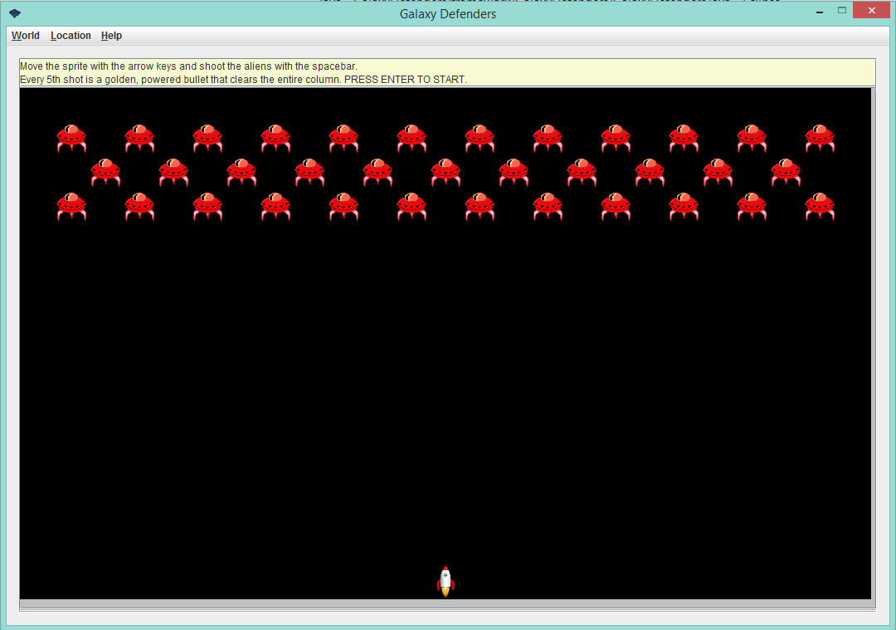
GalaxyDefenders Demo (Initial)
Initial start screen
Gives instructions regarding sprite movement and shooting
Informs player about 5th bullet power-up
Aliens don’t move until enter key is pressed
Notes:
andy

Slide 20
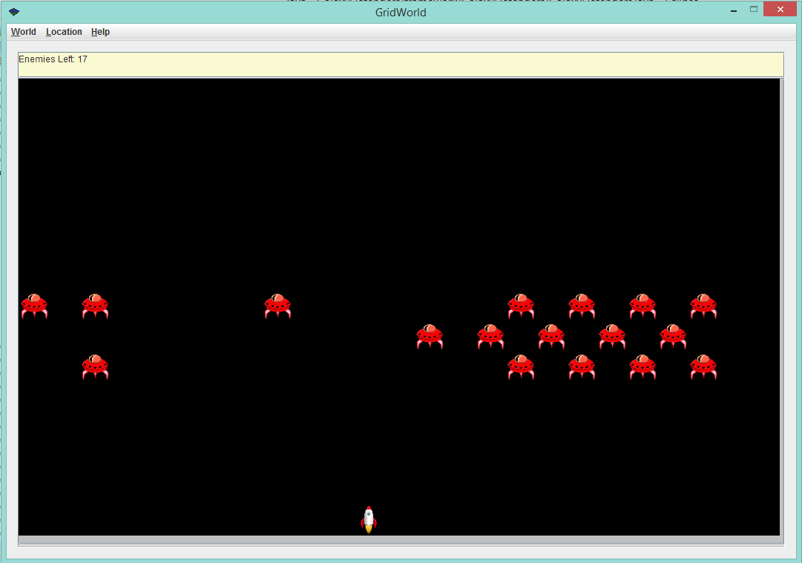
GalaxyDefenders Demo (Mid-Game)
Occurs when enter key is pressed and aliens have been eliminated
Message with instructions replaced with a count of number of enemies left
Aliens approach the sprite
Notes:
andy

Slide 21
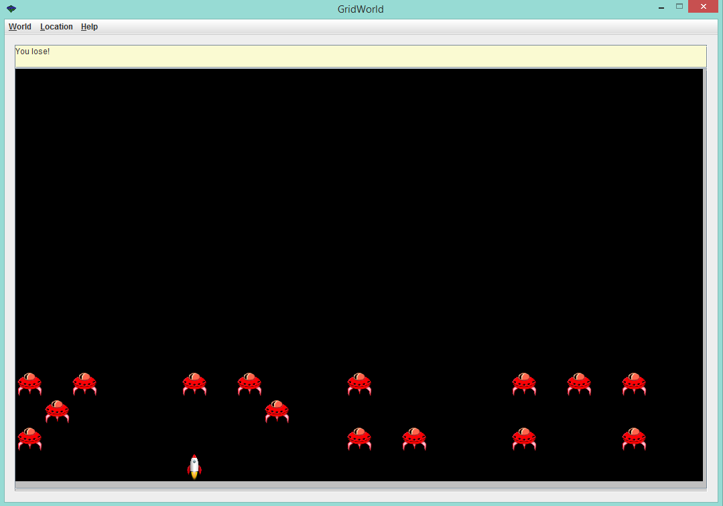
GalaxyDefenders Demo (Losing Screen)
Occurs when aliens have reached the row directly above the sprite
Message with count of number of aliens is replaced with a “You lose!” message
Notes:
andy

Slide 22
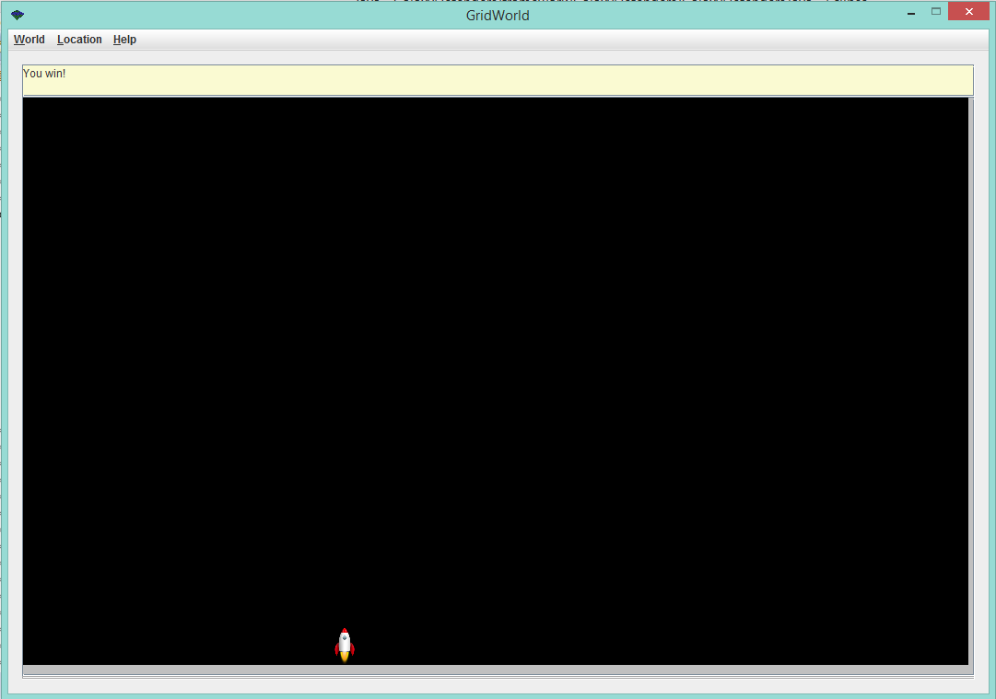
GalaxyDefenders Demo (Winning Screen)
Occurs when all aliens have been eliminated
Message with count of number of aliens is replaced with a “You win!” message
Notes:
andy

Slide 23
Testing
JUnit Testing
methods, constructors in each class
common actions
utilizes GridWorld’s Location class, contains()
Notes:
pavan

Slide 24
Standards
javadoc comments
java conventions - indenting, naming
declaring and initializing - constructor, parameters
Notes:
pavan

Slide 25
Standards
messages - displayed clearly in GUI
Object-driven design
Methods are unique in function, support scaling
Notes:
pavan

Slide 26
Reflections
Strengths: coding process
Weaknesses: devising general outline
How to Improve: better delegation/clearer strategy
Notes:
pavan

